Slide 1
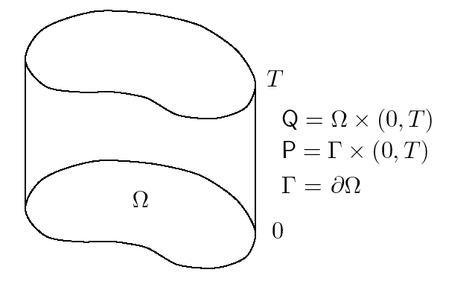
Incompressible Navier-Stokes Equations

Slide 2
Incompressible Navier-Stokes Equations

Slide 3
Variational Semi-Discrete Formulation

Slide 4
Variational Multiscale Formulation
Split
Finite dimensional subspace
Standard FE, spectral or NURBS space, etc.
Fine-scales
Original problem becomes:

Slide 5
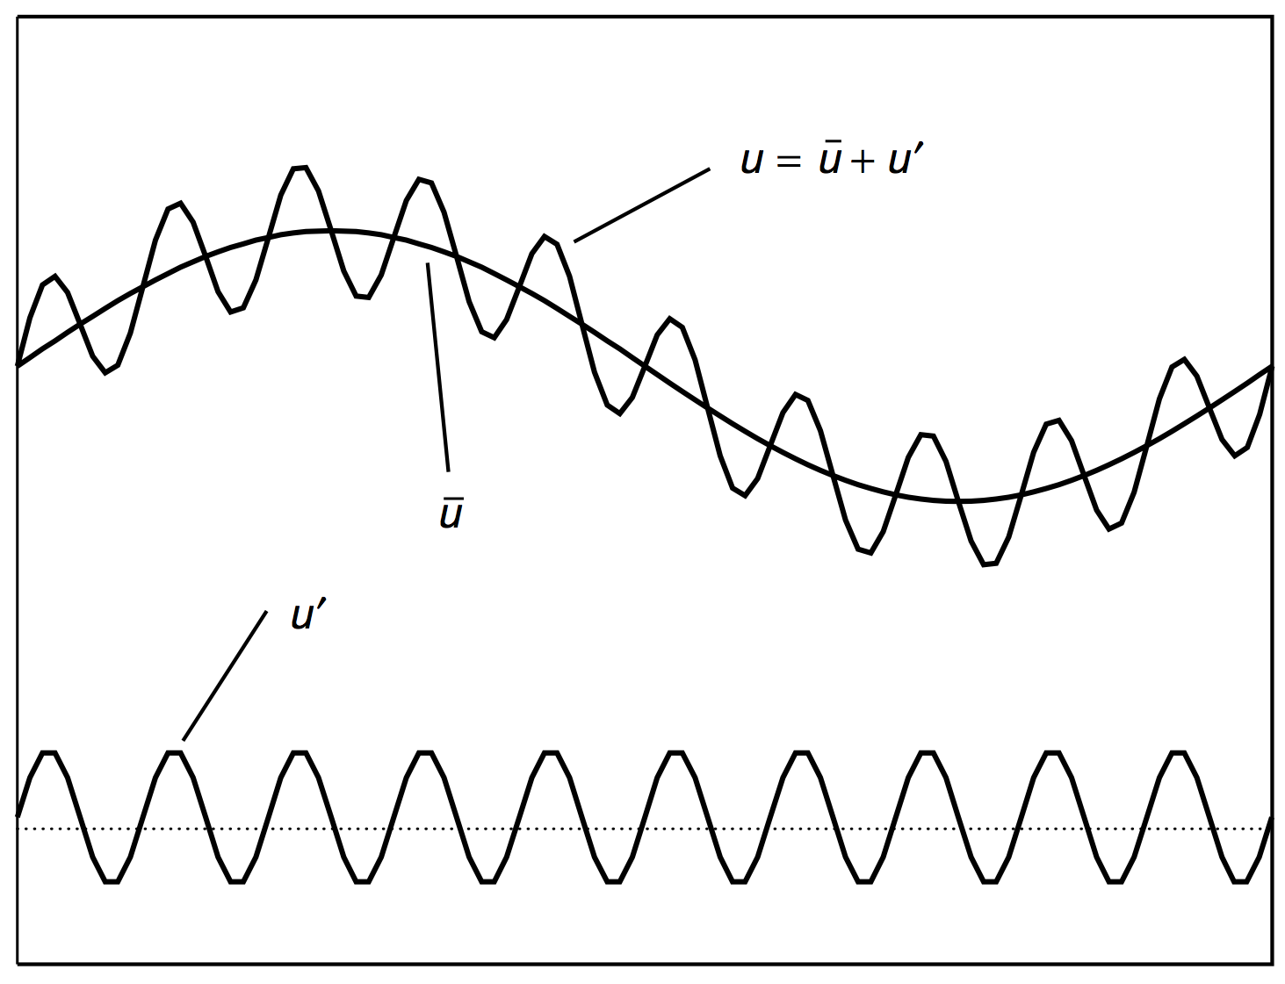
Variational Multiscale (VMS)

Slide 6
Variational Multiscale Method

Slide 7
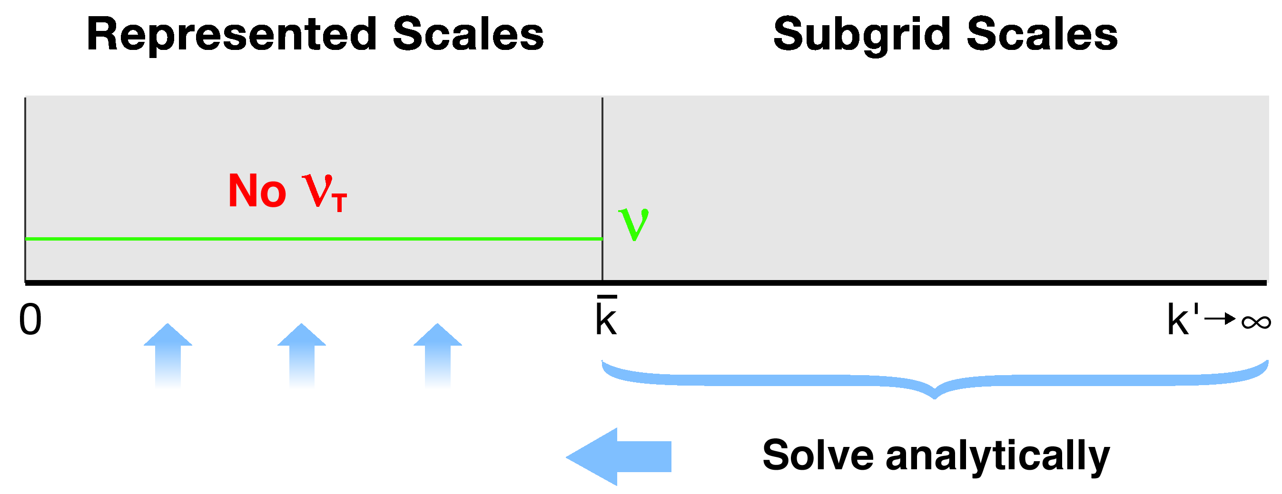
Variational Multiscale Method

Slide 8
Residual-Driven Turbulence Modeling
Fine-scale approximation:

Slide 9
Discrete “Conservative” Form
Galerkin
terms
Multiscale
Terms

Slide 10
Comparison with Classical Stabilized Methods
Coarse-scale equation
Remarks
These terms omitted in classical stabilized methods
Extension of the ideas of SUPG, GLS and MS
No eddy viscosity

Slide 11
Forced Isotropic Turbulence
NURBS (B-splines)
Linears (standard hexahedral finite elements), C⁰
Meshes: 32³, 64³, 128³ , 256³
Quadratics, C¹
Meshes: 32³, 64³, 128³
Cubics, C²
Meshes: 32³, 64³
Uniform mesh in all three directions
Statistics:
Energy spectra
Third-order structure functions
Forcing of three lowest modes of the velocity field at each instant
Power input kept constant (P_{input} = 62.8)
Samples taken ~0.4 T_{eddy} apart

Slide 12
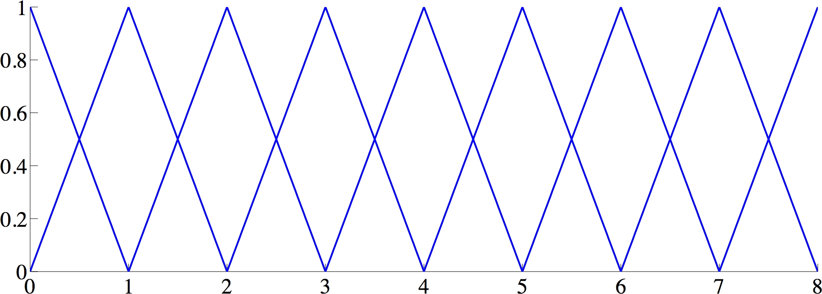
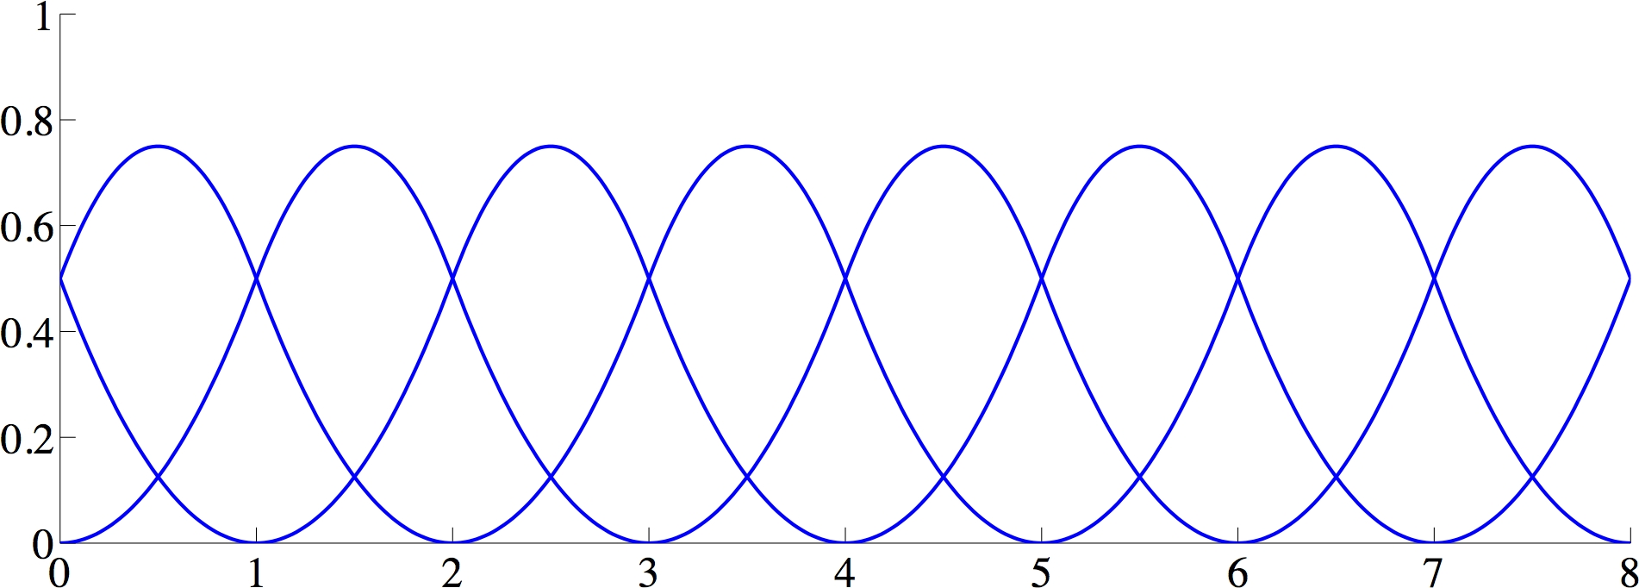
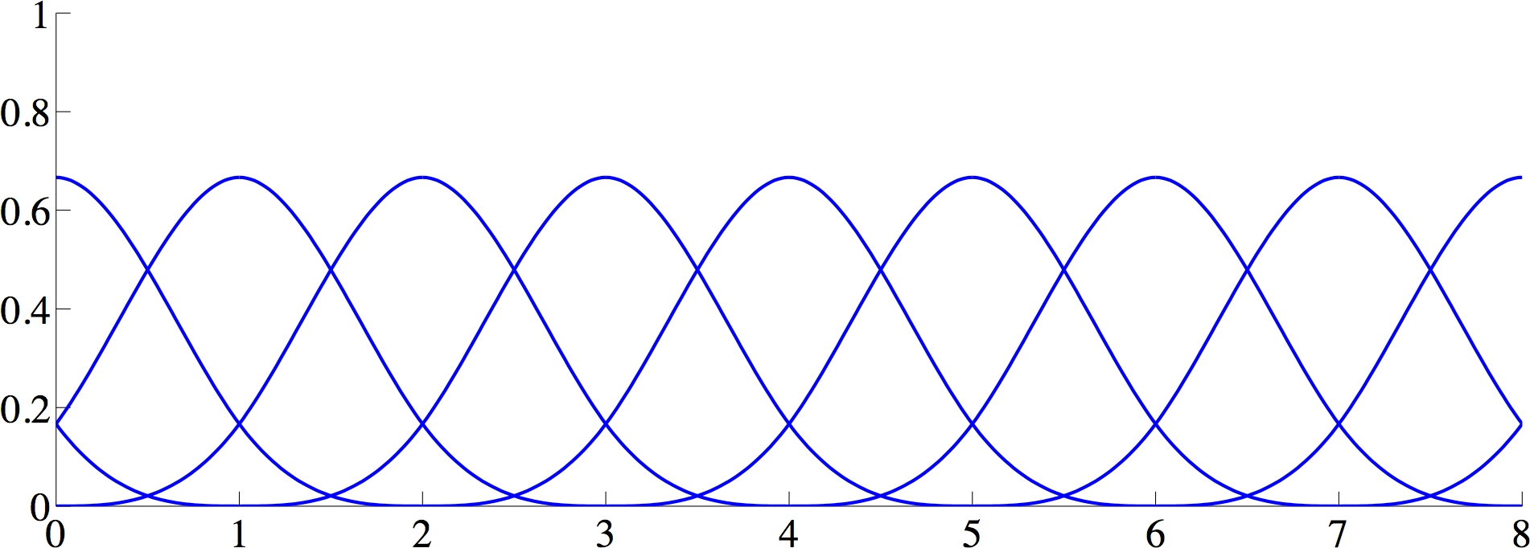
Periodic NURBS (B-spline) Basis Functions
Linears
Quadratics
Cubics

Slide 13
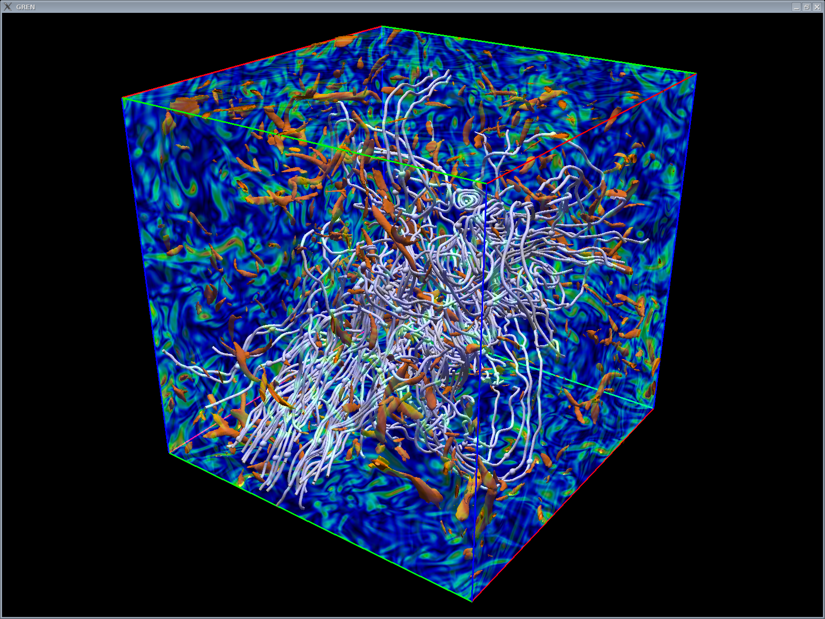
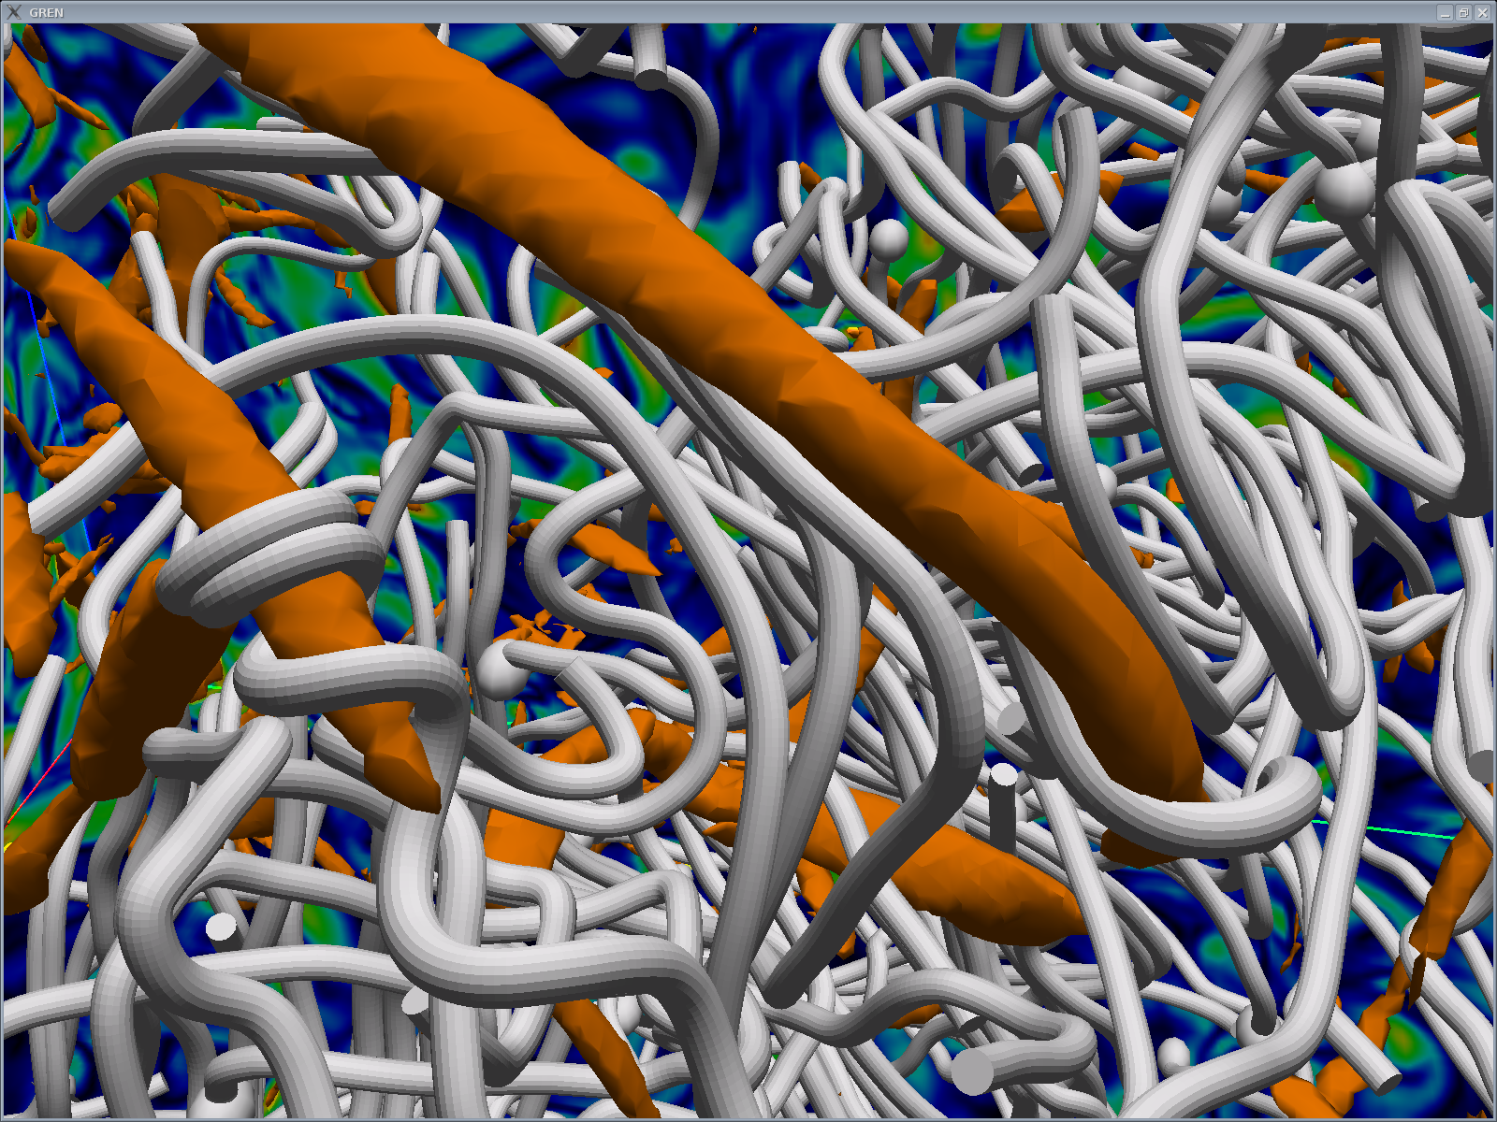
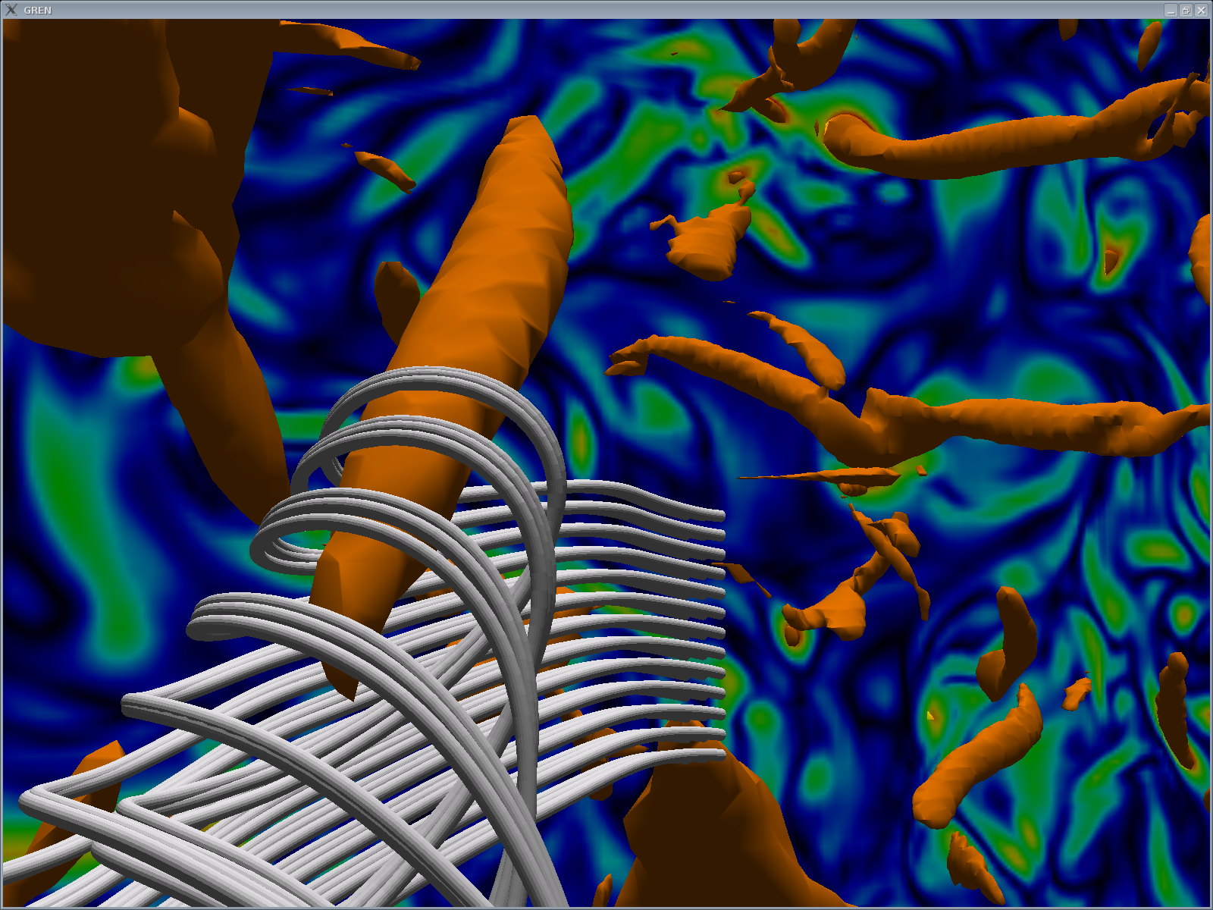
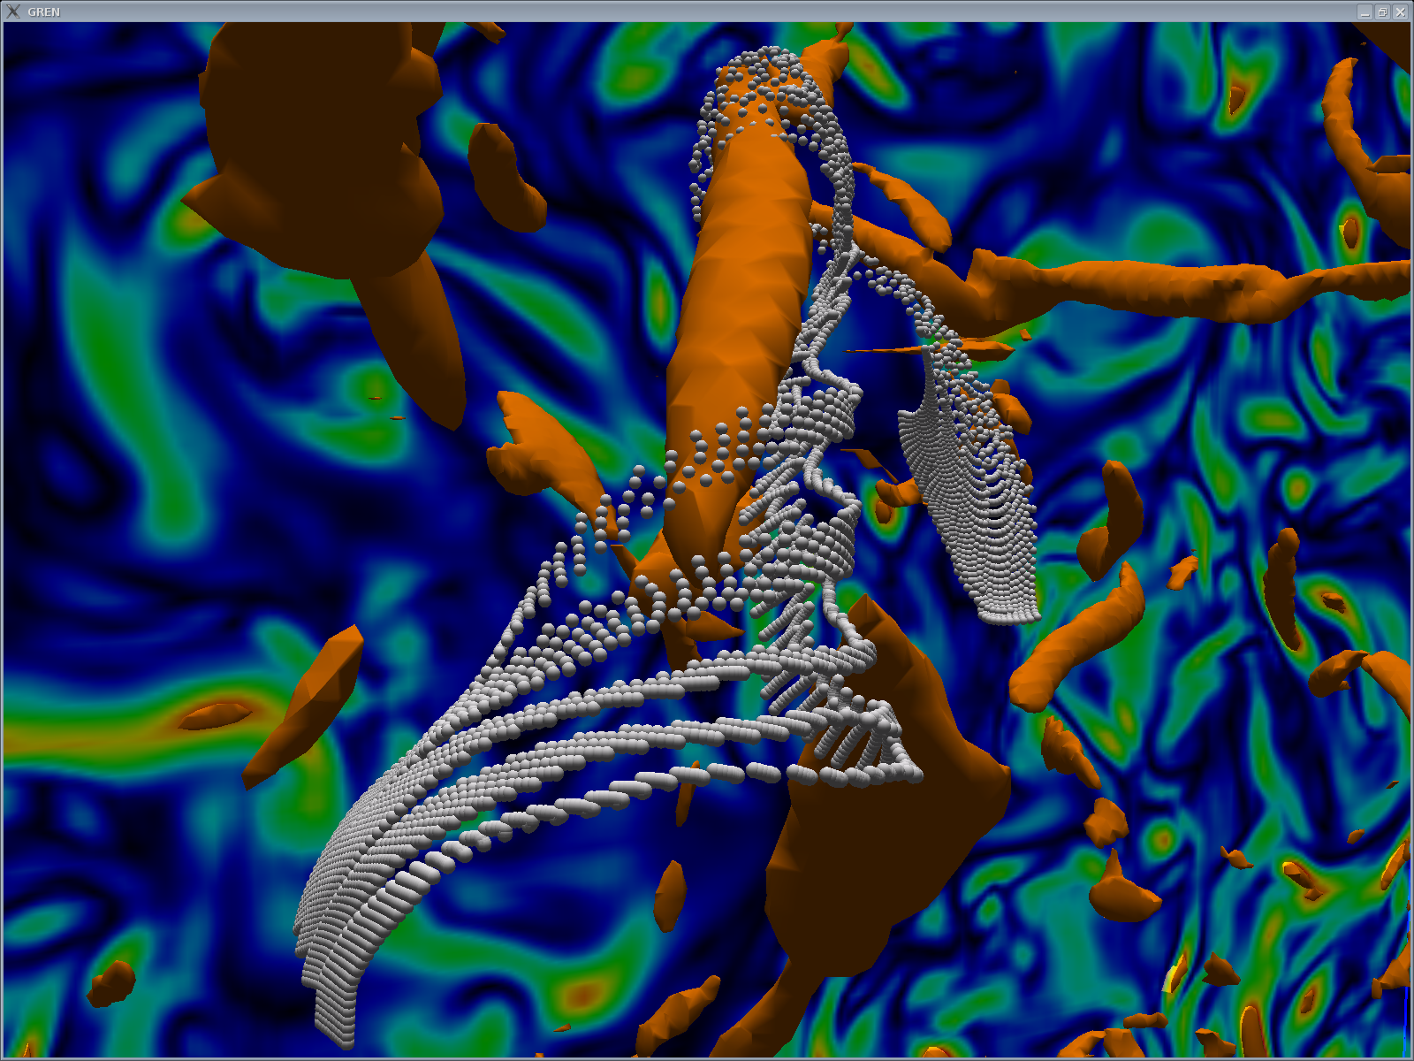
Vorticity isosurfaces and streamlines

Slide 14
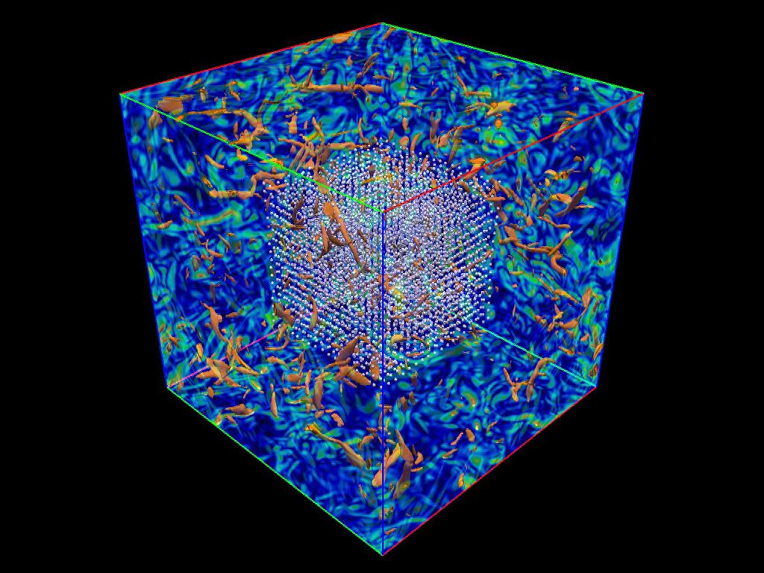

Slide 15
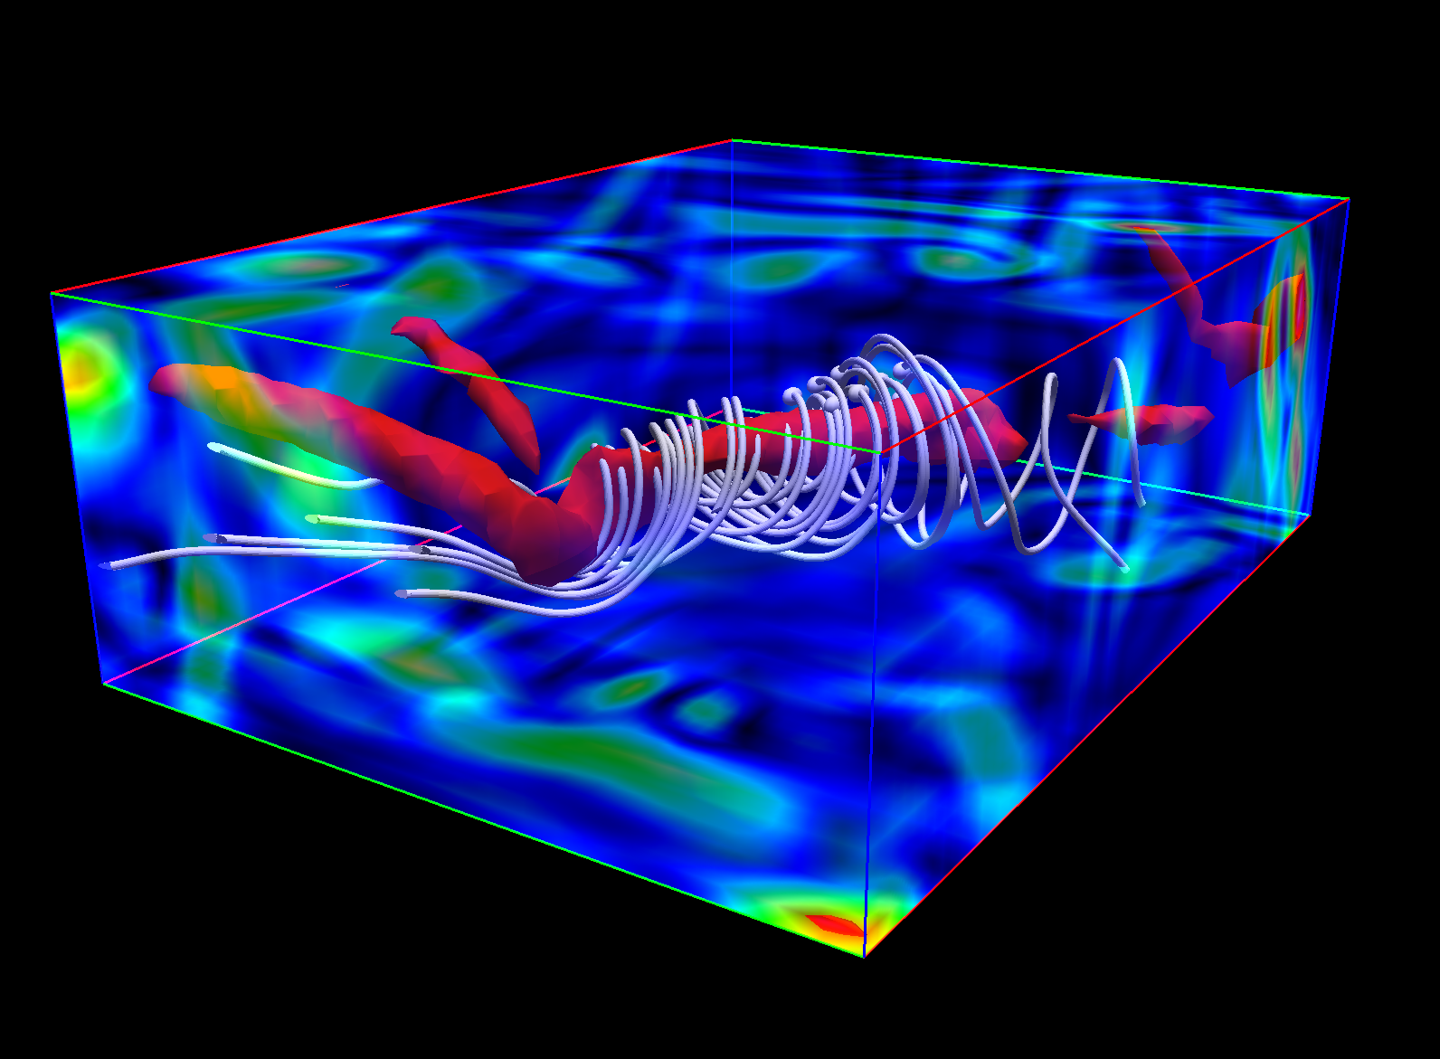
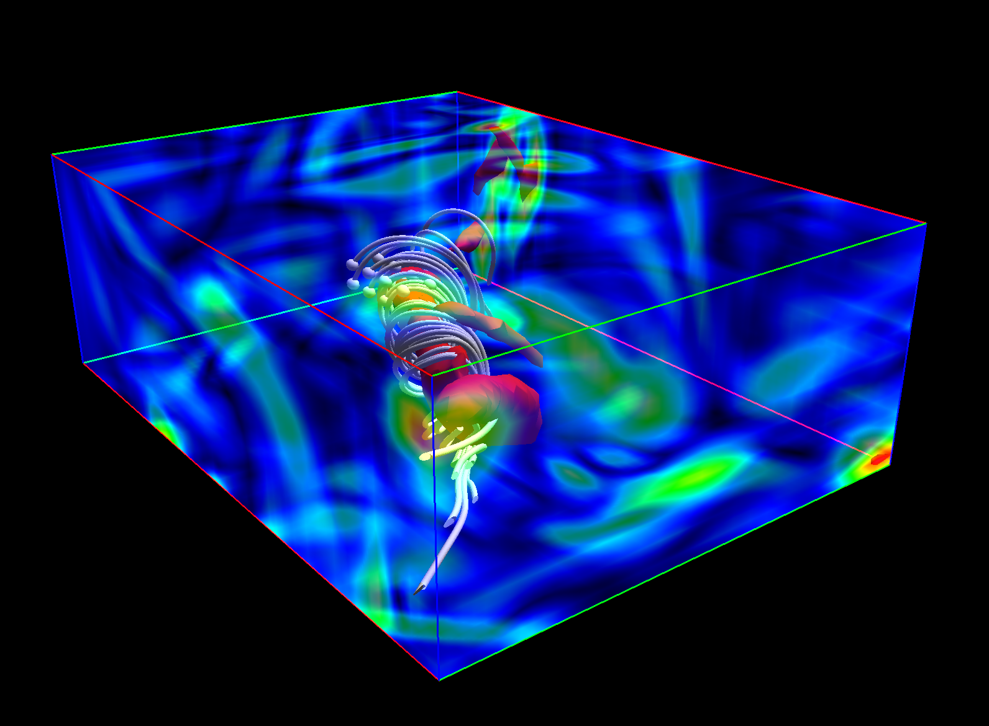
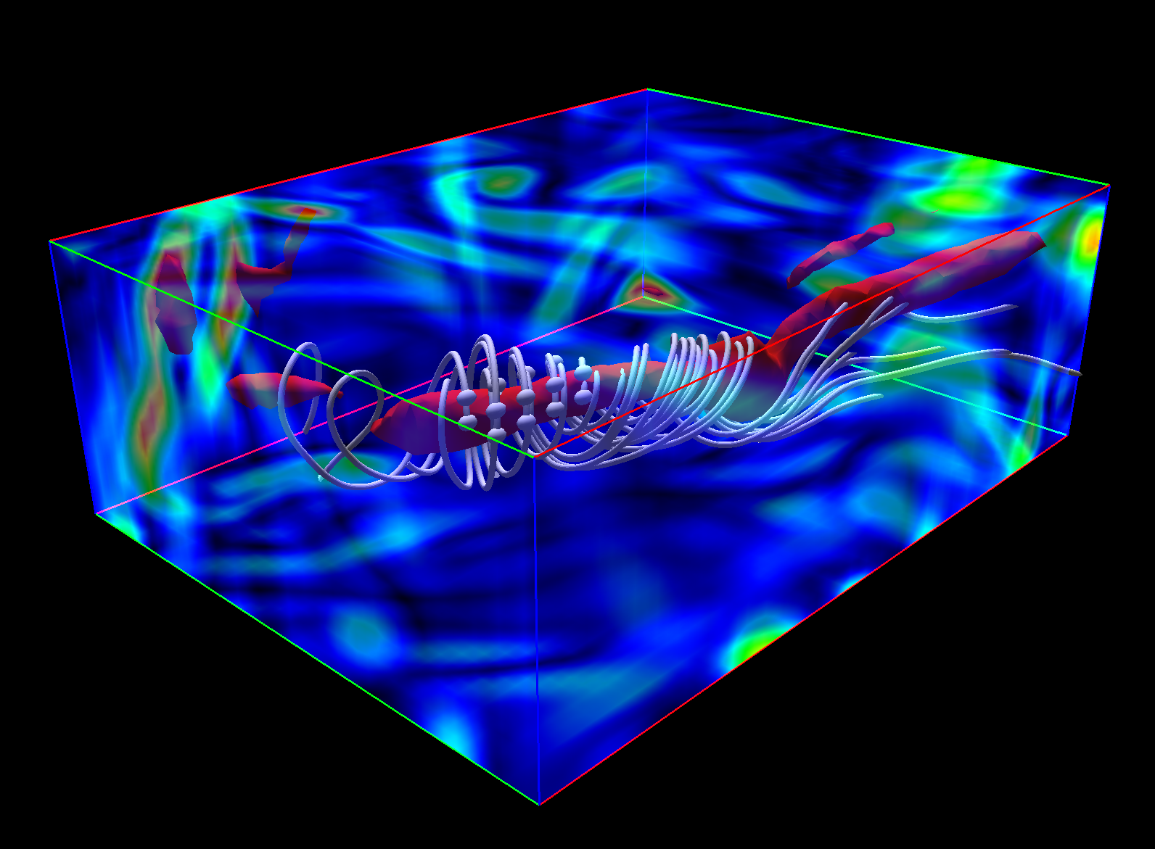
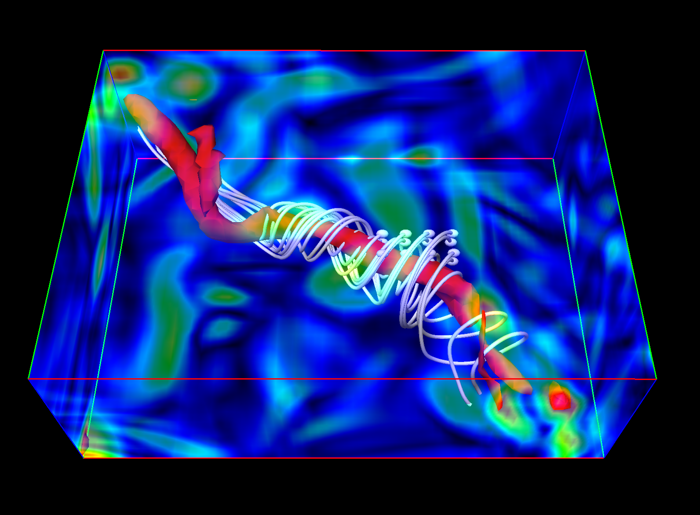
Vorticity isosurfaces and streamlines

Slide 16
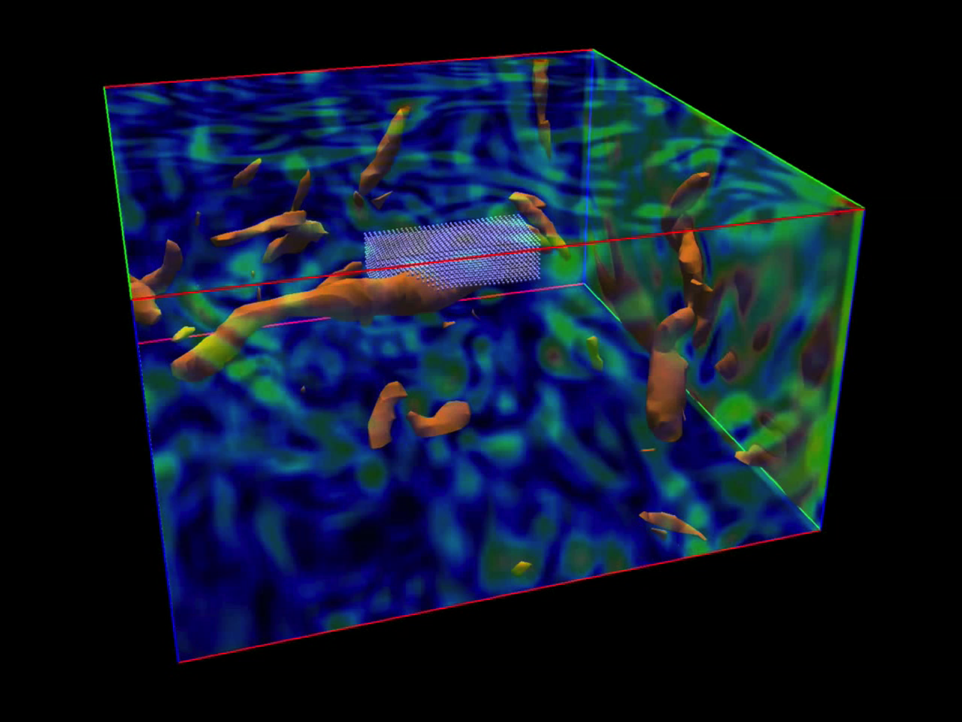

Slide 17
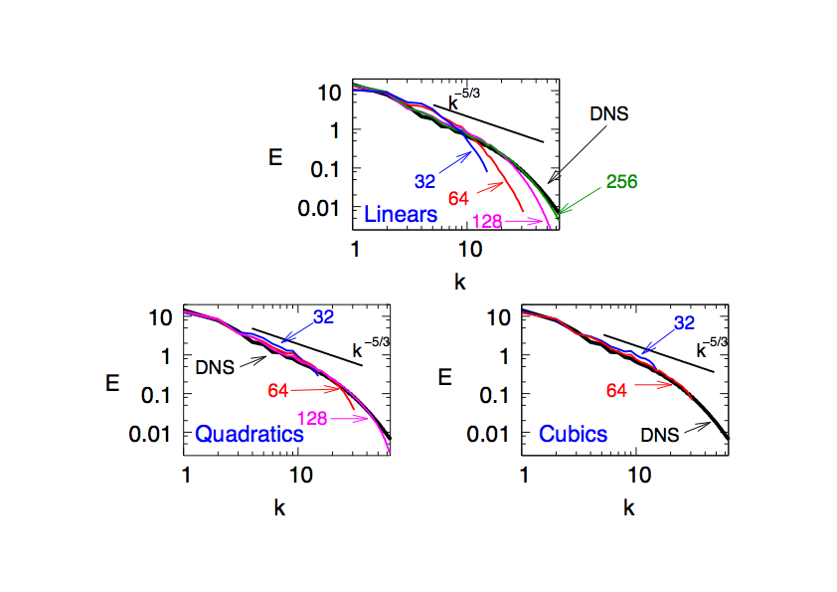
Energy Spectra Re_{λ}=164 (h-refinement)

Slide 18
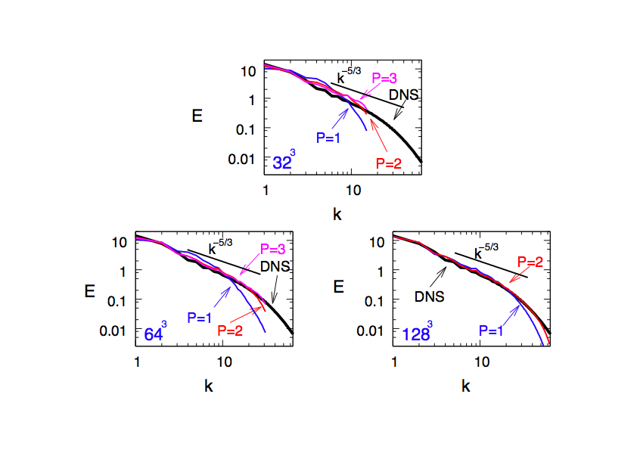
Energy Spectra Re_{λ}=164 (k-refinement)

Slide 19
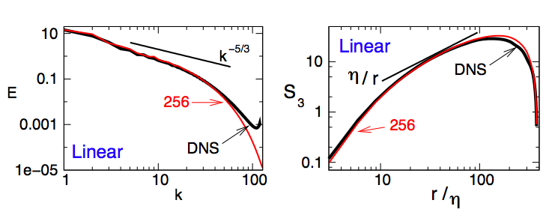
Energy Spectra and Third-order Structure Function Re_{λ}=164
Energy pile-up for spectral method (cf. Guermond)

Slide 20
Formulation for this Class
Galerkin
terms
Multiscale
Terms

Slide 21
Formulation for this Class
Galerkin
terms
Multiscale
Terms

Slide 22
Formulation for this Class
Galerkin
terms
Multiscale
Terms

Slide 23
Formulation for this Class
Galerkin
terms
Multiscale
Terms

Slide 24
Formulation for this Class
Galerkin
terms
Multiscale
Terms

